Slide 1
Basic config Router

Slide 2
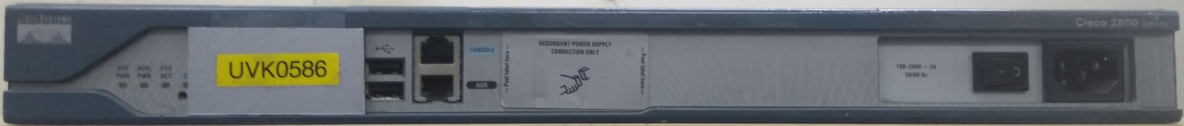
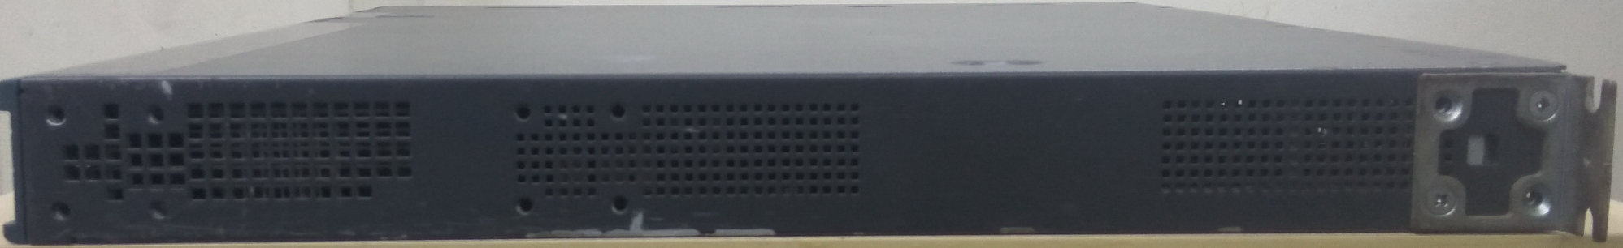
Router Cisco 2811
Notes:
Note:
RAM—Packet buffers, running configurations, running Cisco IOS
ROM—POST, ROM monitor, baby Cisco IOS (Rxboot)
NVRAM—Backup configurations, config register
Flash—Cisco IOS
Flash memory is nonvolatile. It behaves like a file system. It is more expensive than NVRAM. It is readable and writeable. The 2500 routers run from Flash. If it is running Cisco IOS from Flash, then the Flash is in the readable state. Use the boot system command to boot Cisco IOS from a TFTP server so the 2500 can run from RAM if you need to write or erase Flash online.

Slide 3
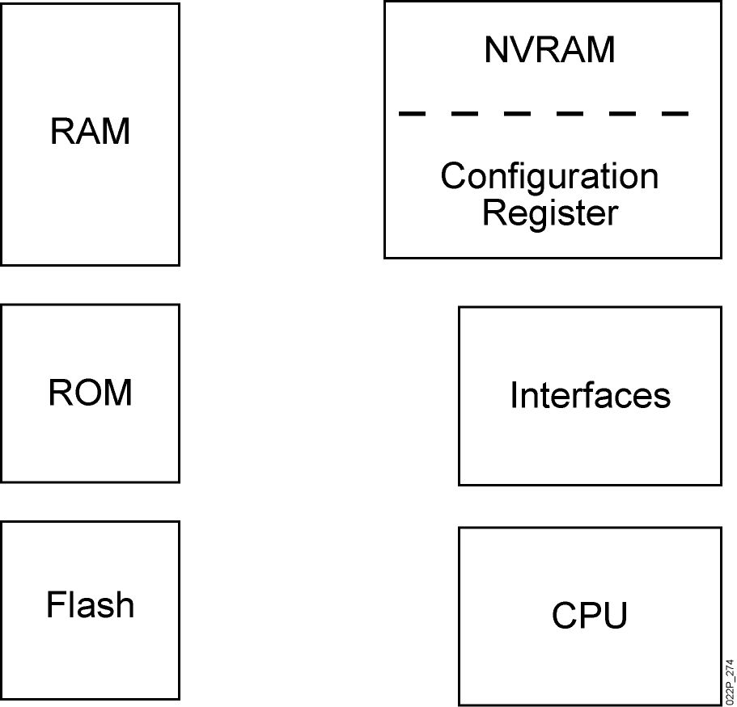
Router Internal Components
Notes:
Note:
RAM—Packet buffers, running configurations, running Cisco IOS
ROM—POST, ROM monitor, baby Cisco IOS (Rxboot)
NVRAM—Backup configurations, config register
Flash—Cisco IOS
Flash memory is nonvolatile. It behaves like a file system. It is more expensive than NVRAM. It is readable and writeable. The 2500 routers run from Flash. If it is running Cisco IOS from Flash, then the Flash is in the readable state. Use the boot system command to boot Cisco IOS from a TFTP server so the 2500 can run from RAM if you need to write or erase Flash online.

Slide 4
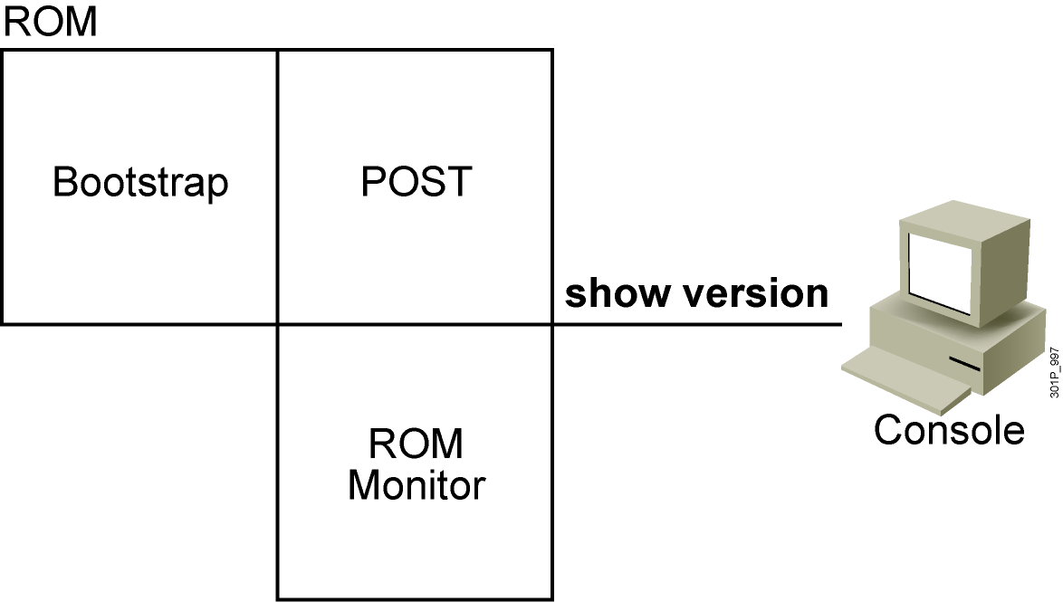
ROM Functions
Contains microcode for basic functions
Notes:
Note: Mini Cisco IOS is the Rxboot mode.
One use of the ROM monitor is for password recovery. From ROM monitor, you can set the config register to 0x2142 so the NVRAM will be ignored during startup.

Slide 5
Router Power-On Boot Sequence
Perform power-on self-test (POST).
Load and run bootstrap code.
Find the Cisco IOS Software.
Load the Cisco IOS Software.
Find the configuration.
Load the configuration.
Run the configured Cisco IOS Software.
Notes:
Emphasize: In a later slide, there is a very detailed flowchart of the router startup process.

Slide 6
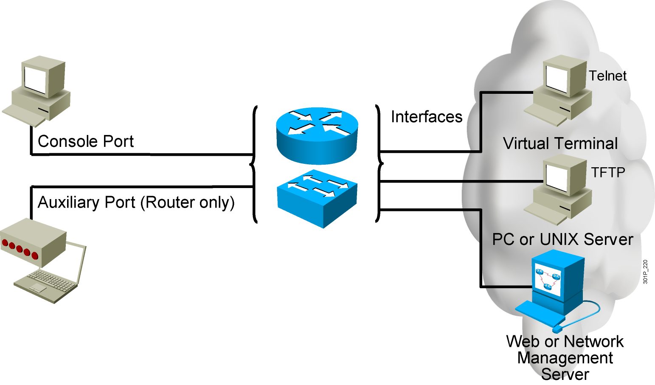
External Configuration Sources
  Configurations can come from many sources.
  Configurations will act in device memory.
Notes:
Purpose: This slide describes the different ways students can access the Catalyst switch or Cisco router to create a new configuration file or alter an existing one.
Emphasize: The network device can be configured from several locations. After you create the initial configuration, you can configure the ports or interfaces to enable configuration over virtual terminal ports (vty).
Both the router and switch support Telnet access as a virtual terminal.
The router by default supports virtual terminals 0 through 4. The router can be accessed for configuration purposes from the console port, the auxiliary port, and five VTY lines at the same time—up to seven people can configure the router at once.
You should caution students about the above point and inform them that security should be strictly observed through password protection to avoid unauthorized access of the configuration files.
Another component important to configuration in the network is a TFTP server.
The TFTP server can be a UNIX or PC workstation that acts as a central depository for files.
You can keep configuration files on the TFTP server and then download them to the device.
You can also configure them from a network management station running network management software such as CWSI, CiscoWorks, or HP OpenView. Before you can access or change the configuration from a virtual terminal, TFTP server, or network management station, you must have the device configured to support IP traffic.

Slide 7
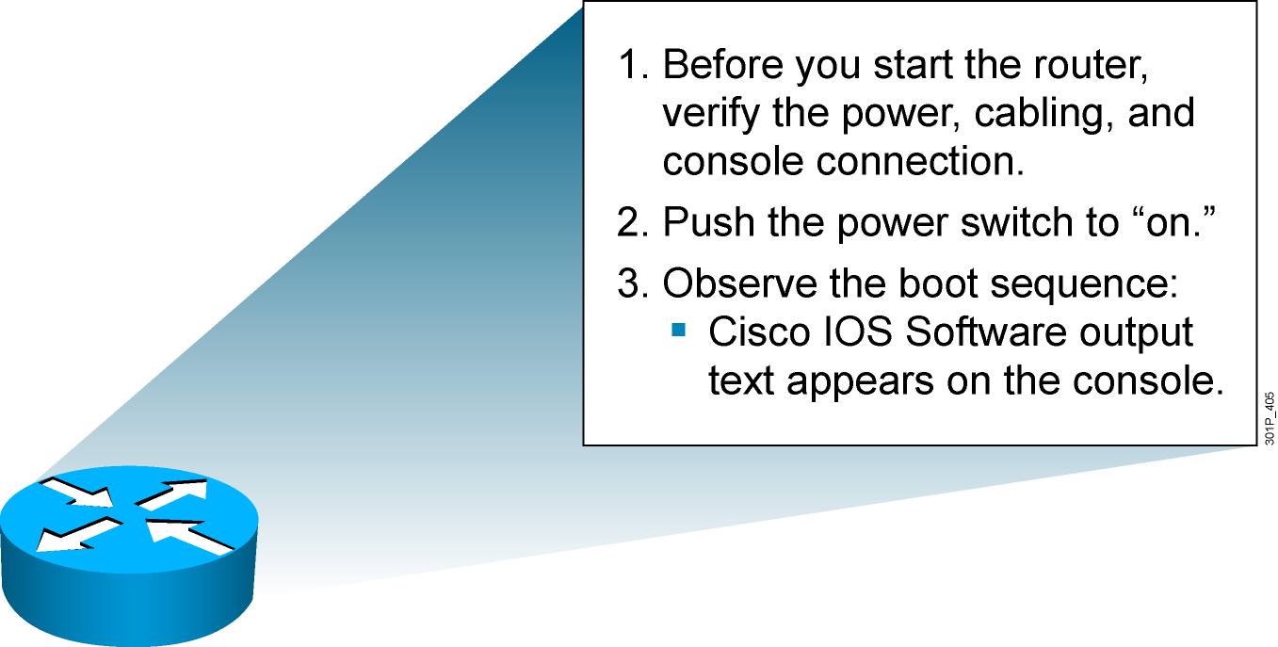
Initial Startup of the Cisco Router
  System startup routines initiate router software
  Router falls back to startup alternatives if needed
Notes:
Purpose: This slide describes a high-level overview of the startup sequences on the router.
Emphasize: A detailed flowchart covers this in much more detail in Chapter 6, “Catalyst Switch Operations.” Config register is also covered in Chapter 6.
The startup routines for Cisco IOS software have the goal of starting router operations. The router must deliver reliable performance connecting the user networks it was configured to serve. To do this, the startup routines must:
Make sure that the router comes up with tested hardware.
Find and load the Cisco IOS software that the router uses for its operating system.
Find and apply the configuration statements about router-specific attributes, protocol functions, and interface addresses.
The router will make sure that it comes up with tested hardware. When a Cisco router powers up, it performs a POST. These diagnostics verify the basic operation of the CPU, memory, and interface circuitry. After verifying the hardware functions, the router proceeds with software initialization. Some startup routines act as fallback operations that are able to perform the router startup should other routines be unable to do so. This flexibility allows Cisco IOS software to start up in a variety of initial situations.

Slide 8
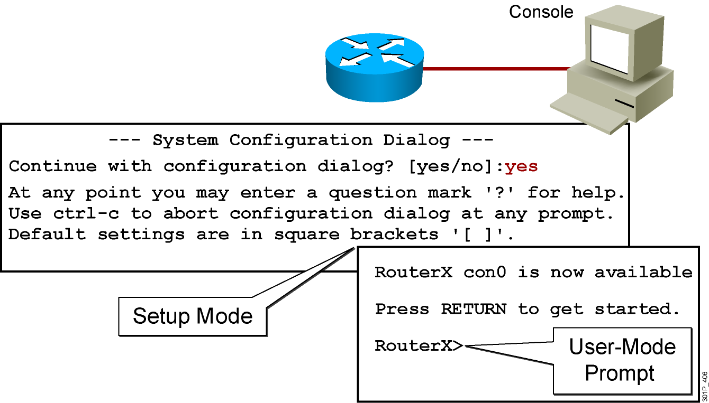
Bootup Output from the Router
Unconfigured vs. Configured Router
Notes:
Purpose: This slide describes the difference between the console output of an unconfigured router and a configured router.
Emphasize: The router has setup mode to prompt the user for an initial configuration. The Catalyst 1900 switch has no setup mode, it comes with a factory default configuration.
Transition: The next series of slides shows the setup mode prompting.
Note: The setup mode prompting on Cisco IOS Release 12.0 is different than pre-release 12.0.

Slide 9
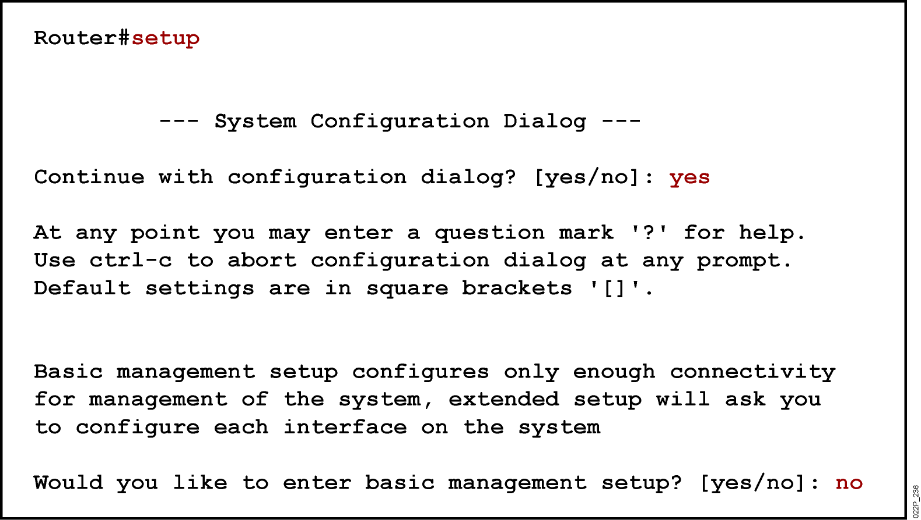
Setup: The Initial Configuration Dialog
Notes:
Purpose: This slide describes the setup mode on the router.
Emphasize: One routine for initial configuration is the setup mode. The primary purpose of the setup mode is to rapidly bring up a minimal-feature configuration for any router that cannot find its configuration from some other source.
For many of the prompts in the system configuration dialog of the setup command facility, default answers appear in square brackets ([ ]) following the question. Pressing the Return key allows you to use the defaults. If the system was previously configured, the defaults that appear are the currently configured values. If you are configuring the system for the first time, the factory defaults are provided. If there is no factory default, as in the case of passwords, nothing is displayed after the question mark (?).
At this point, you can choose not to continue with the system configuration dialog and exit by entering No at the prompt. To begin the initial configuration process, enter Yes. You can press Ctrl-C to terminate the process and start over at any time. When you are using the command form of setup (Router#setup), Ctrl-C returns you to the privileged EXEC prompt (Router#).
If a “-- More --” prompt appears, press the space bar to continue.
Note: When the student performs the router setup mode lab later, make sure they select “no” at the “Would you like to enter basic management setup?” prompt.

Slide 10
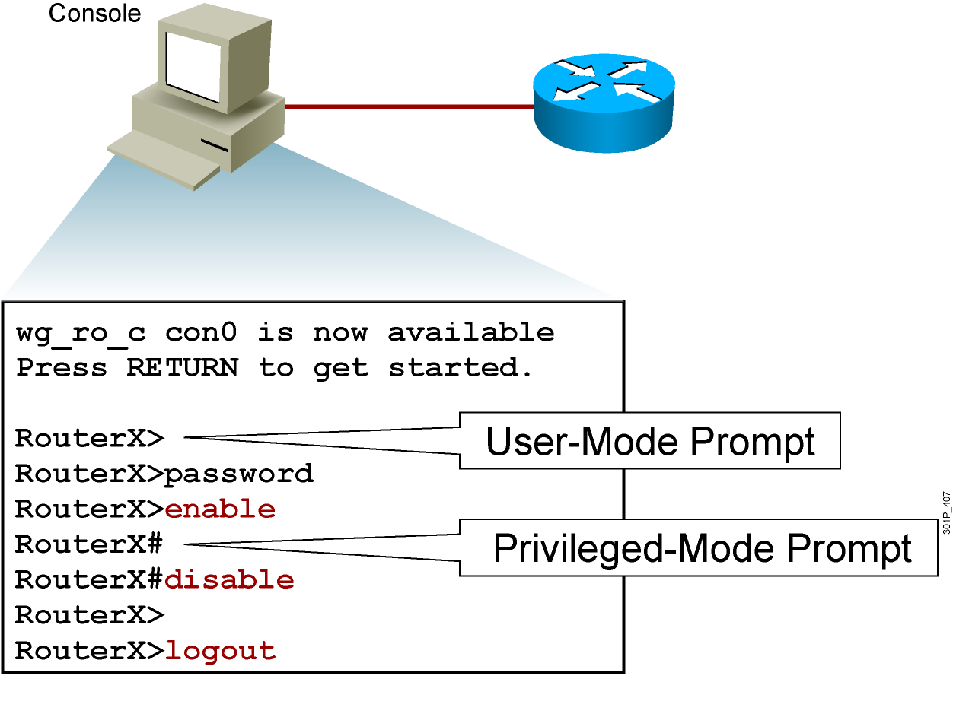
Logging in to the Cisco Router
Notes:
Purpose: This slide discusses the two EXEC modes.
Emphasize: Teach your students to look for and identify the prompt that indicates if they are in the correct mode for a given command.

Slide 11
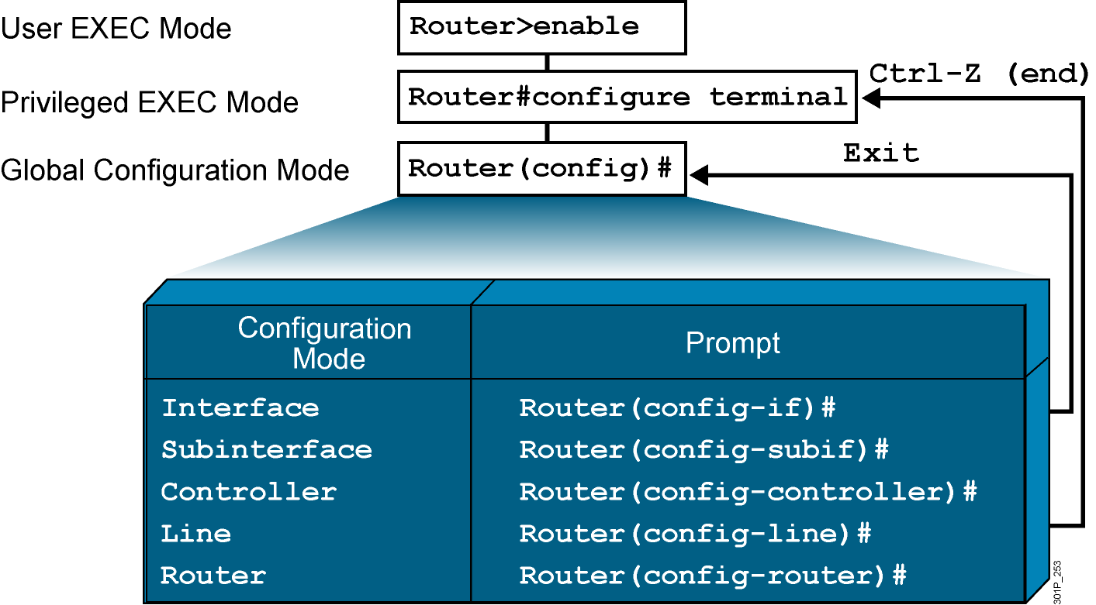
Overview of Router Modes
Notes:
Emphasize: Here is a list of some of the configuration modes available.
For a complete list of the router configuration modes, refer to the Cisco Documentation CD-ROM.

Slide 12
Router User-Mode Command List
RouterX>?
Exec commands:
access-enable Create a temporary Access-List entry
access-profile Apply user-profile to interface
clear Reset functions
connect Open a terminal connection
disable Turn off privileged commands
disconnect Disconnect an existing network connection
enable Turn on privileged commands
exit Exit from the EXEC
help Description of the interactive help system
lat Open a lat connection
lock Lock the terminal
login Log in as a particular user
logout Exit from the EXEC
-- More --
You can abbreviate a command to the fewest characters that make a unique character string.
Notes:
Emphasize: Notice that there are more commands available on the router than the Catalyst 1900 switch.

Slide 13
Router Privileged-Mode Command List
RouterX#?
Exec commands:
access-enable Create a temporary Access-List entry
access-profile Apply user-profile to interface
access-template Create a temporary Access-List entry
bfe For manual emergency modes setting
cd Change current directory
clear Reset functions
clock Manage the system clock
configure Enter configuration mode
connect Open a terminal connection
copy Copy from one file to another
debug Debugging functions (see also 'undebug')
delete Delete a file
dir List files on a filesystem
disable Turn off privileged commands
disconnect Disconnect an existing network connection
enable Turn on privileged commands
erase Erase a filesystem
exit Exit from the EXEC
help Description of the interactive help system
-- More --
You can complete a command string by entering the unique character string, then pressing the Tab key.
Notes:
Emphasize: Notice that there are more commands available on the router than the Catalyst 1900 switch.

Slide 14
show version Command
Cisco IOS Software, 2800 Software (C2800NM-ADVIPSERVICESK9-M), Version 12.4(12), RELEASE SOFTWARE (fc1)
Technical Support: http://www.cisco.com/techsupport
Copyright (c) 1986-2006 by Cisco Systems, Inc.
Compiled Fri 17-Nov-06 12:02 by prod_rel_team
ROM: System Bootstrap, Version 12.4(13r)T, RELEASE SOFTWARE (fc1)
RouterX uptime is 2 days, 21 hours, 15 minutes
System returned to ROM by power-on
System image file is "flash:c2800nm-advipservicesk9-mz.124-12.bin"
This product contains cryptographic features and is subject to United States and local country laws governing import, export, transfer and use. Delivery of Cisco cryptographic products does not imply
third-party authority to import, export, distribute or use encryption. Importers, exporters, distributors and users are responsible for compliance with U.S. and local country laws. By using this product you agree to comply with applicable laws and regulations. If you are unable to comply with U.S. and local laws, return this product immediately.
A summary of U.S. laws governing Cisco cryptographic products may be found at:
http://www.cisco.com/wwl/export/crypto/tool/stqrg.html
If you require further assistance please contact us by sending email to
export@cisco.com.
Cisco 2811 (revision 53.50) with 249856K/12288K bytes of memory.
Processor board ID FTX1107A6BB
2 FastEthernet interfaces
2 Serial(sync/async) interfaces
1 Virtual Private Network (VPN) Module
DRAM configuration is 64 bits wide with parity enabled.
239K bytes of non-volatile configuration memory.
62720K bytes of ATA CompactFlash (Read/Write)
Configuration register is 0x2102
RouterX#
Notes:
Purpose: This slide presents the show version command.
Emphasize: Point out that this command is useful when troubleshooting problems because it gives the versions of the various software components and files. It also displays how long the router has been in operation and where it obtained the image file.
Config register is discussed in Chapter 6, “Catalyst Switch Operations.”

Slide 15
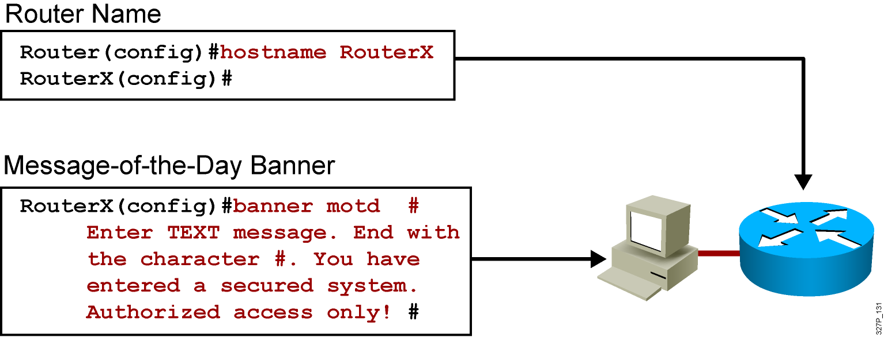
Configuring Router Identification
Notes:
Slide 2 of 2
Emphasize: Layer 2—The interface description command allows you to enter a one-line descriptive statement for each interface. This description is displayed in the output from the show interfaces command and appears in the show running-config and show startup-config listings.

Slide 16
Console-Line Commands
RouterX(config)#line console 0
RouterX(config-line)#exec-timeout 20 30
  Modifies console session timeout
RouterX(config)#line console 0
RouterX(config-line)#logging synchronous
  Redisplays interrupted console input
Notes:
Emphasize: If the student enters no exec by mistake, the console port EXEC mode will be disabled once the student is logged out of the current session. If this happens, you have to break into the router using ROM monitor to recover (set the config reg to 0x2142 so it will ignore NVRAM).

Slide 17
Configuring an Interface
RouterX(config)#interface type number
RouterX(config-if)#
  type includes serial, ethernet, token ring, fddi, hssi, loopback, dialer, null, async, atm, bri, tunnel, and so on
  number is used to identify individual interfaces
RouterX(config)#interface type slot/port
RouterX(config-if)#
  For modular routers, selects an interface
RouterX(config-if)#exit
  Quits from current interface configuration mode
Notes:
Purpose: This slide shows the interface configuration mode.
Emphasize: The top line is the format of the command used in fixed-port routers. The type field shows the interface type, which can be Ethernet, Token Ring, or another interface. The number field is the number of the interface. For example, if the router has two Ethernet interfaces, and one is known as Ethernet0, the other will be called Ethernet1.
The second command is used on the Cisco 7000 and 7200 series routers, which can accept multiple interface cards with multiple ports on each card. In this case, the first number is the number of the card, or slot number. The second number is the port on the card. For example, on the second interface card, the first Ethernet interface is specified as Ethernet 2/0.
If you have Cisco 7000 and 7500 series routers with VIP cards, you define an interface by slot, port adapters, and port numbers. Port adapters are assigned either a 0 or 1 number.
Use the exit command to leave the current configuration mode.

Slide 18
Configuring an Interface Description
RouterX(config-if)# description string
  string is a comment or a description to help you remember what is attached to this interface.
  The maximum number of characters for the string argument is 238.
Notes:
Purpose: This slide shows the interface configuration mode.
Emphasize: The top line is the format of the command used in fixed-port routers. The type field shows the interface type, which can be Ethernet, Token Ring, or another interface. The number field is the number of the interface. For example, if the router has two Ethernet interfaces, and one is known as Ethernet0, the other will be called Ethernet1.
The second command is used on the Cisco 7000 and 7200 series routers, which can accept multiple interface cards with multiple ports on each card. In this case, the first number is the number of the card, or slot number. The second number is the port on the card. For example, on the second interface card, the first Ethernet interface is specified as Ethernet 2/0.
If you have Cisco 7000 and 7500 series routers with VIP cards, you define an interface by slot, port adapters, and port numbers. Port adapters are assigned either a 0 or 1 number.
Use the exit command to leave the current configuration mode.

Slide 19
Disabling or Enabling an Interface
RouterX#configure terminal
RouterX(config)#interface serial 0
RouterX(config-if)#shutdown
%LINK-5-CHANGED: Interface Serial0, changed state to administratively down
%LINEPROTO-5-UPDOWN: Line protocol on Interface Serial0, changed state to down
  Administratively turns off an interface
RouterX#configure terminal
RouterX(config)#interface serial 0
RouterX(config-if)#no shutdown
%LINK-3-UPDOWN: Interface Serial0, changed state to up
%LINEPROTO-5-UPDOWN: Line Protocol on Interface Serial0, changed state to up
  Enables an interface that is administratively shut down
Notes:
Emphasize: The Catalyst 1900 switch also uses the shut and no shut command.

Slide 20
Configuring IP Addresses
RouterX#configure terminal
RouterX(config)#interface serial 0
RouterX(config-if)#ip address 192.168.1.1 255.255.255.0
RouterX(config-if)#no shutdown
%LINK-3-UPDOWN: Interface Serial0, changed state to up
%LINEPROTO-5-UPDOWN: Line Protocol on Interface Serial0, changed state to up
Notes:
Purpose: This is an introduction slide to the IP addressing section.
Emphasize: Stations with internetwork access must have unique addresses.

Slide 21
Router show interfaces Command
RouterX#show interfaces
Ethernet0 is up, line protocol is up
Hardware is Lance, address is 00e0.1e5d.ae2f (bia 00e0.1e5d.ae2f)
Internet address is 10.1.1.11/24
MTU 1500 bytes, BW 10000 Kbit, DLY 1000 usec, rely 255/255, load 1/255
Encapsulation ARPA, loopback not set, keepalive set (10 sec)
ARP type: ARPA, ARP Timeout 04:00:00
Last input 00:00:07, output 00:00:08, output hang never
Last clearing of "show interface" counters never
Queueing strategy: fifo
Output queue 0/40, 0 drops; input queue 0/75, 0 drops
5 minute input rate 0 bits/sec, 0 packets/sec
5 minute output rate 0 bits/sec, 0 packets/sec
81833 packets input, 27556491 bytes, 0 no buffer
Received 42308 broadcasts, 0 runts, 0 giants, 0 throttles
1 input errors, 0 CRC, 0 frame, 0 overrun, 1 ignored, 0 abort
0 input packets with dribble condition detected
55794 packets output, 3929696 bytes, 0 underruns
0 output errors, 0 collisions, 1 interface resets
0 babbles, 0 late collision, 4 deferred
0 lost carrier, 0 no carrier
0 output buffer failures, 0 output buffers swapped out
Notes:
Purpose: This slide presents the show interfaces command, which indicates whether the network is operating at the physical and data link layers. The command output is interpreted later in this chapter.
Emphasize: The top line of the output tells us that the line is up. A few lines down, the output provides the IP address, and below that some characteristics like BW for bandwidth, and DLY for delay. On the next line down, we find an encapsulation type of ARPA. ARPA means Ethernet II, which is the default IP encapsulation type for Ethernet interfaces on Cisco routers.
A runt is an Ethernet frame that is too small to be legal (less than 64 bytes), and a giant is an Ethernet frame that is too big (greater than 1518 bytes).

Slide 22
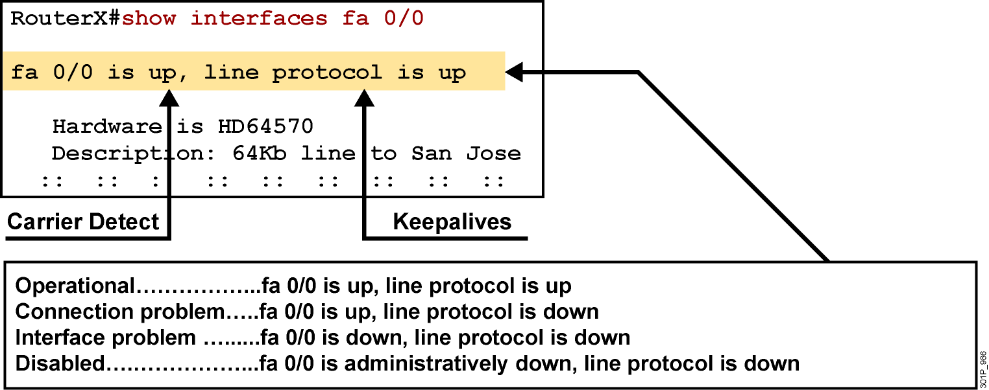
Interpreting the Interface Status
Notes:
Purpose: This slide explains how to interpret the show interfaces serial command output.
Emphasize: The show interfaces serial command output indicates that the serial interface is up and the line protocol is up. The first parameter refers to the hardware layer and essentially reflects whether the interface is receiving the Carrier Detect signal from the other end. The second parameter refers to the data link layer. This parameter reflects whether the data link layer protocol keepalives are being received.
If both the interface and the line protocol are up, the connection is operational.
If the hardware is up and the line protocol is down, a connection problem exist such as no clocking, wrong encapsulation type, or no keepalives.
If both the line protocol and the interface are down, a cable might never have been attached to the router. On the serial cable, you can plug in the cable upside-down, causing the pins on the serial cable to break.
There is one more possibility. If the information says “administratively down,” you have manually disabled (shut) the interface.
Cisco offers a hardware class (IMCR) that discusses the router hardware in more detail.

Slide 23
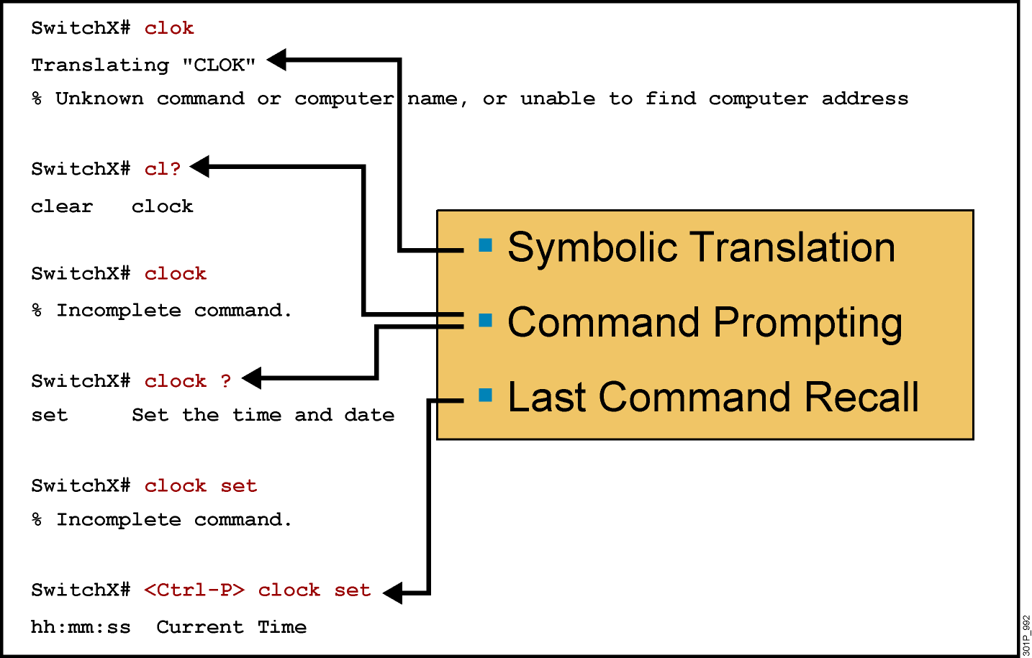
Context-Sensitive Help
Notes:
Slide 1 of 2
Emphasize: Suppose you want to set the router clock. If you do not know the command, use context-sensitive help to check the syntax for setting the clock. The help output shows that the set keyword is required. Next, check the syntax for entering the time.
Now enter the current time using hours, minutes, and seconds, as shown.
The system indicates that you need to provide additional arguments to complete the command. Press Ctrl-P (or Up arrow) to repeat the previous command entry automatically. Then add a space and a question mark (?) to reveal the additional arguments.
Now you can complete the command entry.
The caret symbol (^) and help response indicate an error. To list the correct syntax, reenter the command up to the point where the error occurred, and then enter a question mark (?).
Enter the year using the correct syntax and press Return to execute the command.
Note that the user interface provides syntax checking in the form of an error location indicator (^). The caret symbol character appears at the point in the command string where you entered an incorrect command, keyword, or argument. The error location indicator and interactive help system allow you to find and correct syntax errors easily.

Slide 24
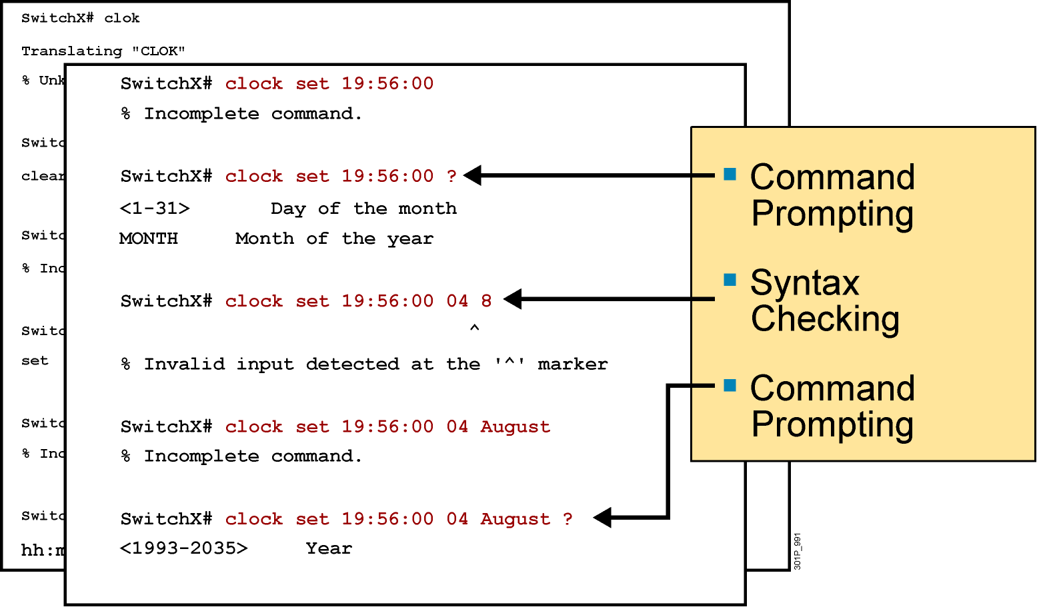
Context-Sensitive Help (Cont.)
Notes:
Slide 2 of 2

Slide 25
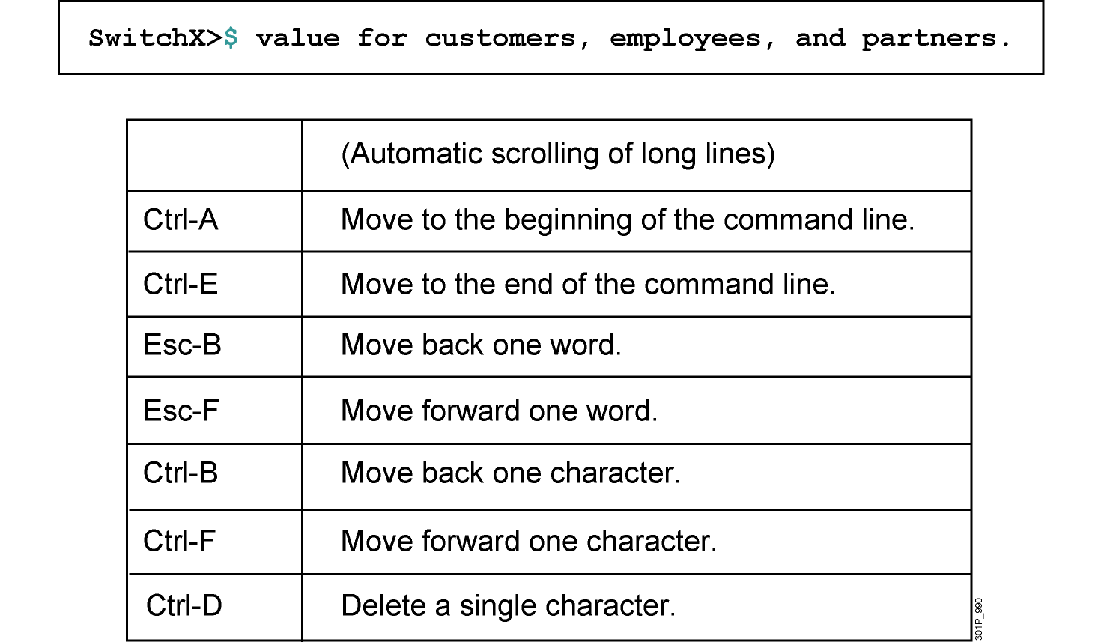
Enhanced Editing Commands (Cont.)
Notes:
Layer 9 of 9
Emphasize: Layer 9 — Ctrl-D deletes a single character.

Slide 26
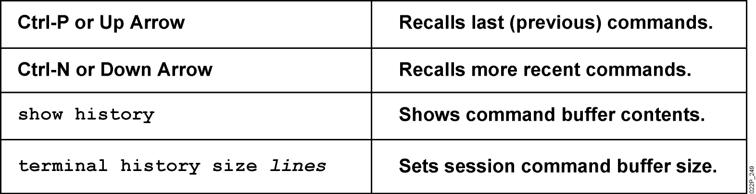
Router Command History
Notes:
Emphasize: The user interface provides a history or record of commands you have entered. This feature is particularly useful for recalling long or complex commands or entries. With the command history feature, you can complete the following tasks:
Set the command history buffer size
Recall commands
Disable the command history feature
By default, command history is enabled and the system records ten command lines in its history buffer. To change the number of command lines the system will record during the current terminal session, use the terminal history size or history size command. The maximum number of commands is 256.
To recall commands in the history buffer beginning with the most recent command, press Ctrl-P or the Up arrow key. Repeat the key sequence to recall successively older commands.To return to more recent commands in the history buffer after recalling commands with Ctrl-P or the Up arrow, press Ctrl-N or the Down arrow. Repeat the key sequence to recall successively more recent commands.
Once you enter the unique characters for a command, press the Tab key and the interface will finish the entry for you.
On most laptop computers you may also have additional select and copy facilities available. Copy a previous command string, then paste or insert it as your current string.
Note: The Catalyst 1900 has a fixed history size of ten which can’t be changed.

Slide 27
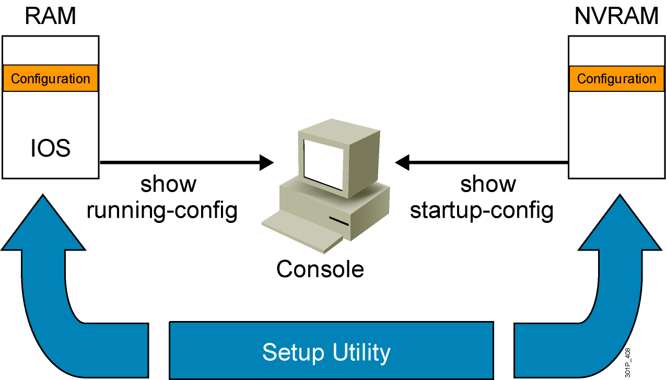
Viewing the Configuration
Notes:
Emphasize: When you exit the setup mode, the configuration can be saved to RAM and NVRAM at the same time.
Note: The Catalyst 1900 has no show start command. It automatically saves the running configuration to NVRAM.

Slide 28
Saving Configurations
RouterX#
RouterX#copy running-config startup-config
Destination filename [startup-config]?
Building configuration…
RourterX#
Copies the current configuration to NVRAM
Notes:
Emphasize: Copying to NVRAM overwrites the contents in NVRAM.

Slide 29
Network Environment Management
CDP - LLDP

Slide 30
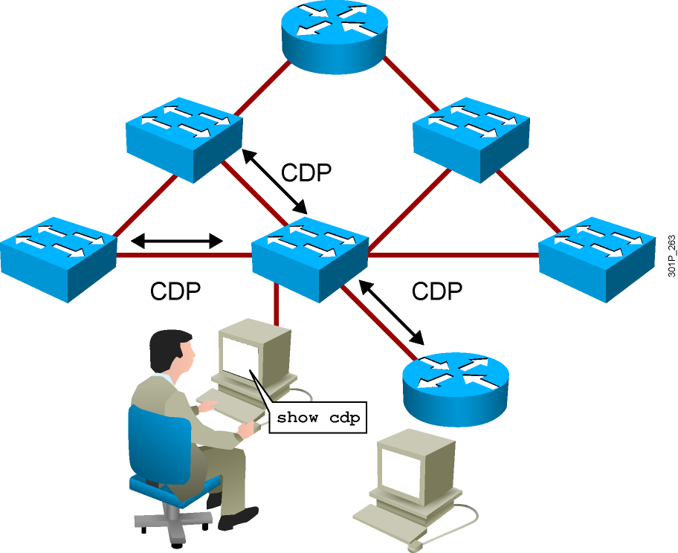
Discovering Neighbors with Cisco Discovery Protocol
  Cisco Discovery Protocol runs on Cisco IOS devices.
  Summary information includes:
    Device identifiers
    Address list
    Port identifier
    Capabilities list
    Platform
Notes:
Emphasize: CDP is media- and protocol-independent and runs on all Cisco-manufactured equipment including routers, access servers, switches, and some managed hubs. With CDP, network management applications can retrieve the device type and SNMP agent address of neighboring devices. This capability enables applications to send SNMP queries to neighboring devices.
CDP allows network management applications to dynamically discover Cisco devices that are neighbors. CDP runs on all media that support the Subnetwork Access Protocol, including LAN and Frame Relay. CDP runs over the data link layer only, not the network layer. Therefore, two systems that support different network-layer protocols can learn about each other.
Cached CDP information is available to network management applications. Cisco devices never forward a CDP packet. When new information is received, old information is discarded. The holdtime determines how long to keep existing information from a neighbor.

Slide 31
Neighbor Discovery Protocols
Cisco Discovery Protocol
Cisco Layer 2 protocol
Has additional capabilities (VLAN or PoE negotiation)
Enabled by default
LLDP
Standard-based Layer 2 protocol
Disabled by default
Provides a summary of directly connected switches, routers, and other Cisco devices
Discovers neighbor devices regardless of which protocol suite they are running

Slide 32
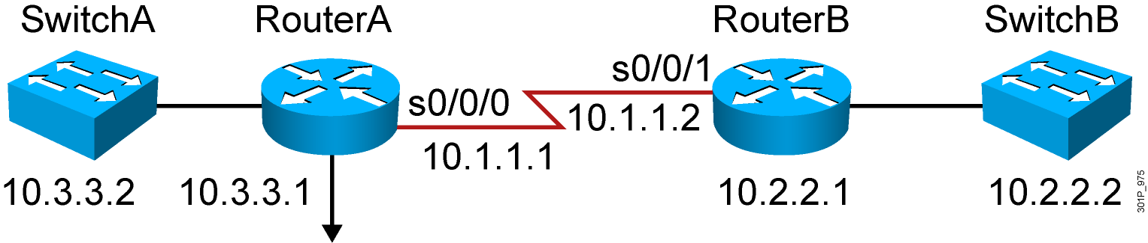
Using Cisco Discovery Protocol
RouterA#show cdp ?
entry Information for specific neighbor entry
interface CDP interface status and configuration
neighbors CDP neighbor entries
traffic CDP statistics
…
RouterA(config)#no cdp run
! Disable CDP Globally
RouterA(config)#interface serial0/0/0
RouterA(config-if)#no cdp enable
! Disable CDP on just this interface
Notes:
Note: Some of the CDP commands are not available on the Catalyst 1900 switch, like cdp run, show cdp traffic, and show cdp entry.

Slide 33
Using the show cdp neighbors Command
RouterA#show cdp neighbors
Capability Codes: R - Router, T - Trans Bridge, B - Source Route Bridge
S - Switch, H - Host, I - IGMP, r - Repeater
Device ID Local Intrfce Holdtme Capability Platform Port ID
SwitchA fa0/0 122 S I WS-C2960- fa0/2
RouterB s0/0/0 177 R S I 2811 s0/0/1
Notes:
Emphasize: This graphic shows the show cdp neighbors command initiated from a router, which displays a summary of the capabilities and access details for the CDP neighbors. The show cdp neighbors detail command shows detailed information about the same devices.
Note: If the neighbor is a Catalyst 1900 switch, the switch MAC address is also displayed. If the switch is a 2900xl, its MAC address is not displayed.

Slide 34
Using the show cdp entry Command
Device ID: RouterB
Entry address(es):
IP address: 10.1.1.2
Platform: Cisco 2811, Capabilities: Router Switch IGMP
Interface: Serial0/0/0, Port ID (outgoing port): Serial0/0/1
Holdtime : 155 sec
Version :
Cisco IOS Software, 2800 Software (C2800NM-ADVIPSERVICESK9-M), Version 12.4(12), RELEASE SOFTWARE (fc1)
Technical Support: http://www.cisco.com/techsupport
Copyright (c) 1986-2006 by Cisco Systems, Inc.
Compiled Fri 17-Nov-06 12:02 by prod_rel_team
Notes:
Emphasize: The example shows what information can be obtained about RouterA’s neighbor. CDP is one way to learn about other Cisco devices on the network.

Slide 35
Additional Cisco Discovery Protocol Commands
RouterA#show cdp traffic
CDP counters :
Total packets output: 8680, Input: 8678
Hdr syntax: 0, Chksum error: 0, Encaps failed: 5
No memory: 0, Invalid packet: 0, Fragmented: 0
CDP version 1 advertisements output: 0, Input: 0
CDP version 2 advertisements output: 8680, Input: 8678
RouterA#show cdp interface s0/0/0
Serial0/0/0 is up, line protocol is up
Encapsulation PPP
Sending CDP packets every 60 seconds
Holdtime is 180 seconds
Notes:
Note: The holdtime indicates how long the neighbor information will be kept in the local CDP table.

Slide 36

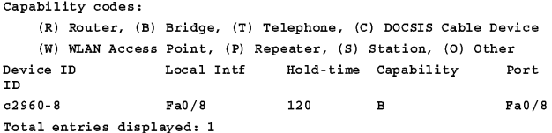
LLDP Configuration
switch# show lldp neighbor

Slide 37



phamthaikhanh@iuh.edu.vn
This Photo by Unknown Author is licensed under CC BY-NC

